Slide 1
Predicting Youth Substance Use with Decision Trees and Ensemble Models
Binary & Multi-Class Classification + Regression on National Survey Data
Your Name: Fariha Shah Course/Instructor: Dr. Mendible Date: 4/15/2025

Slide 2
Introduction
Substance use among youth is a critical public health issue.
This Worksheet explores the use of machine learning to predict marijuana use frequency and alcohol initiation age.
Goals:
Classify youth into light, moderate, or heavy marijuana users.
Predict age of first alcohol use using regression.

Slide 3
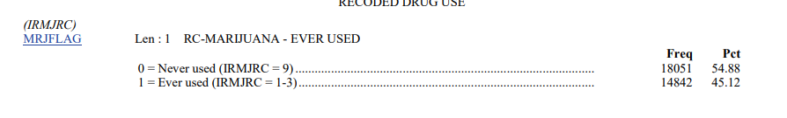
Dataset Overview
Source: National Survey on Drug Use and Health (NSDUH)
Demographic and behavioral responses from youth aged 12–17
Tasks:
Binary classification: Any marijuana use (MRJFLAG)

Slide 4
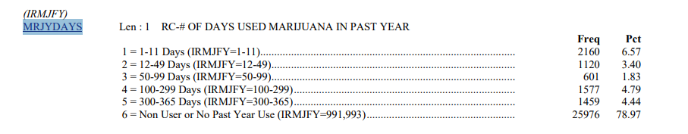
Dataset Overview
Multi-class classification: Frequency of use (MRJYDAYS)
Regression: Age of first alcohol use (IRALCAGE)

Slide 5
Theoretical Background
Decision Trees: Recursive binary splitting to create homogenous groups
Bagging: Bootstrap Aggregation to reduce variance
Random Forest: Bagging of decision trees + feature randomness
Gradient Boosting: Sequential learning, focusing on previous errors

Slide 6
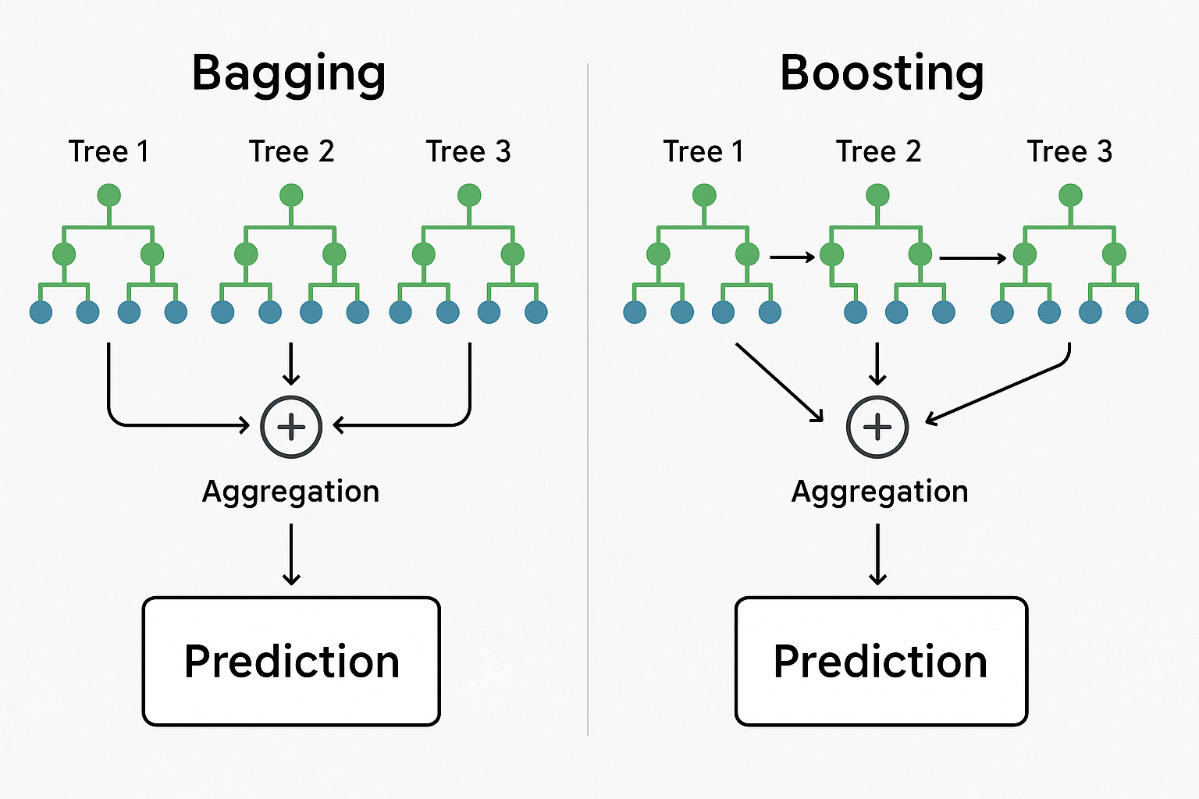
Theoretical Background

Slide 7
Theoretical Background
Model Evaluation Metrics:
Classification: Accuracy, Precision, Recall, F1-Score, Confusion Matrix.
Regression: Mean Squared Error (MSE).
Used GridSearchCV for hyperparameter tuning.

Slide 8
Methodology
Data Processing:
Missing value handling:
Dropped rows with rows containing comma values
Considered imputation but excluded due to categorical nature
Special code handling:
Removed coded values like 991, 993 (e.g., "Never used" or "Unknown")
Feature engineering:
Converted categorical text to numeric via factorization
Created frequency categories: Light (1–2), Moderate (3–4), Heavy (5–6)

Slide 9
Methodology
Model Development:
Split data: 70% train, 30% test.
Applied cross-validation (5-fold, 10-fold).
Tuned trees with GridSearchCV.

Slide 10
Result
Binary Classification (MRJFLAG)
Best Model: Random Forest
Model | Accuracy | Precision(Class =1) | Recall (Class = 1) | F1-Score
Decision Tree | 74% | 37% | 78% | 50%
Pruned Decision Tree | 78% | 40% | 74% | 52%
Random Forest | 84% | 51% | 44% | 47%
Gradient Boosting | 84% | 51% | 43% | 47%
Bagging | 74% | 36% | 77% | 49%

Slide 11
Result
Interpretation
Decision Trees captured more users (high recall), but had lower precision.
Ensemble methods (RF, GB) improved balance across metrics.
Overall, Random Forest is the most reliable model

Slide 12
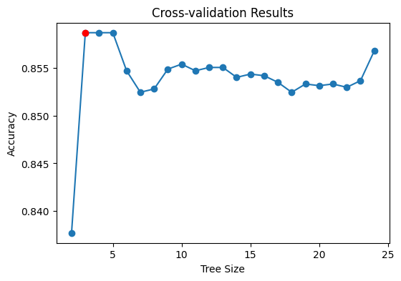
Results
Optimal Tree Size for DecisionTreeClassifier

Slide 13
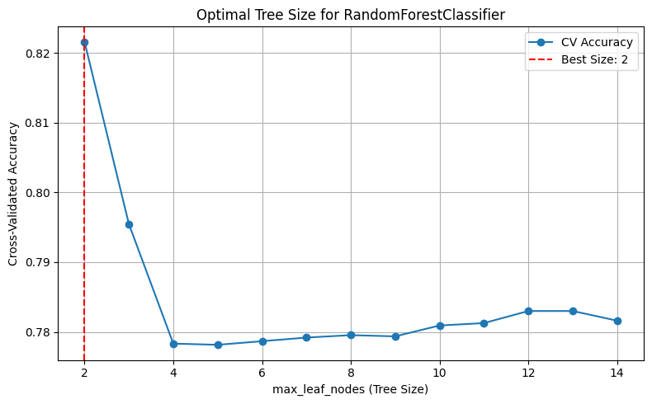
Results

Slide 14
Results
Multi-Class Classification (MRJYDAYS)
Target Classes: Light (0), Moderate (1), Heavy (2)
Model | Accuracy | Macro Avg | Key Issues
Decision Tree | 64.2% | 0.41 | Poor for Light/Moderate
Pruned Tree | 64.24% | 0.41 | Skews toward heavy users
Random Forest | 64.5% | 0.39 | Decent recall for class 1
Gradient Boosting | 87.6% (dropped by 64%) | 0.41 | Only predicts heavy users with 87%, but improving class weights predicts other classes
Bagging | 64% | 0.41 | Predicting target class 2 with 67% recall than class 0 and 1

Slide 15
Results
Interpretation
GB appears best in accuracy, but only predicts one class.
Random Forest best balances recall across all classes.
Severe class imbalance challenges classification quality.

Slide 16
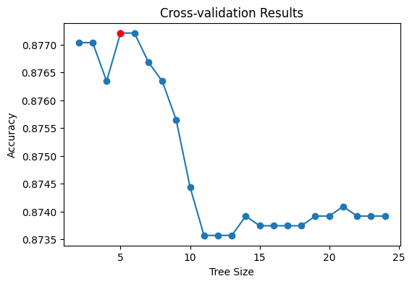
Results
Optimal Tree for DecisionTreeClassifier

Slide 17
Results
Regression (IRALCAGE)
Goal: Predict age of first alcohol use Best Model: Random Forest Regressor
All models show similar predictive ability (~3.7 MSE).
Model | MSE | Top Features
Decision Tree | 3.72 | TALKPROB, YOGRPFT2
Pruned Tree | 3.85 | YOATTAK2, YOSTOLE2
Random Forest | 3.72 | TALKPROB, YOATTAK2
Gradient Boosting | 3.75 | TALKPROB, YOSTOLE2
Bagging | 3.74 | YOFIGHT2, TALKPROB

Slide 18
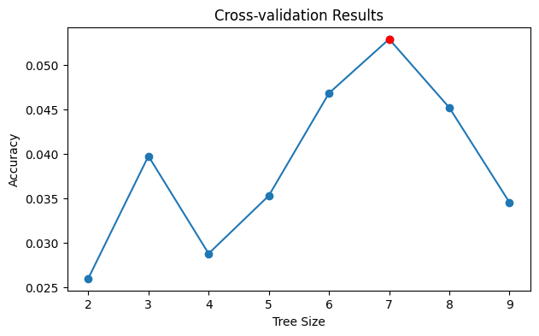
Results

Slide 19
Discussion
Binary Classification Takeaways
RF and GB models perform well overall.
Decision Trees have high recall (good for intervention).
Multi-Class Challenges
Heavy class dominates; Light and Moderate classes are underlearned.
Ensemble models helped, but imbalance persists.

Slide 20
Discussion
Regression
Tree-based models captured moderate signal.
Top features align with risky behavioral patterns.
Limitations
Class imbalance skews predictions.
Risk of overfitting without proper pruning.
Potential bias in survey self-reporting.

Slide 21
Discussion
Improvements
SMOTE or weighted loss for imbalance.
Try other ensembling: XGBoost, CatBoost.
Expand features (e.g., demographics, mental health).

Slide 22
Conclusion
Peer and parental influence strongly affect youth marijuana use.
Class imbalance remains a critical issue in youth behavior modeling.
Tree-based models offer interpretability and stable performance.
Findings can guide public health policies and youth intervention programs.

Slide 23
References
Substance Abuse and Mental Health Services Administration (SAMHSA). (2023). NSDUH Data.
Pedregosa, F., et al. (2011). Scikit-learn: Machine learning in Python.
Hastie, T., Tibshirani, R., & Friedman, J. (2009). The Elements of Statistical Learning.
Imbalanced-learn documentation: https://imbalanced-learn.org/stable/
Scikit-learn documentation: https://scikit-learn.org/stable/

